Slide 1
MongoDB in a nutshell

Slide 2
Agenda
What is NoSQL?
MongoDB
CRUD operations
Living without contraints and transactions
Indexes
Aggregation framework
Notes:
How presentation will benefit audience: Adult learners are more interested in a subject if they know how or why it is important to them.
Presenter’s level of expertise in the subject: Briefly state your credentials in this area, or explain why participants should listen to you.

Slide 3
What is NoSQL ?
NoSQL, is a wide range of technologies and architectures, seeks to solve the scalability and big data performance issues that relational databases weren’t designed to address. NoSQL is especially useful when an enterprise needs to access and analyse massive amounts of unstructured data.
Not Only SQL

Slide 4
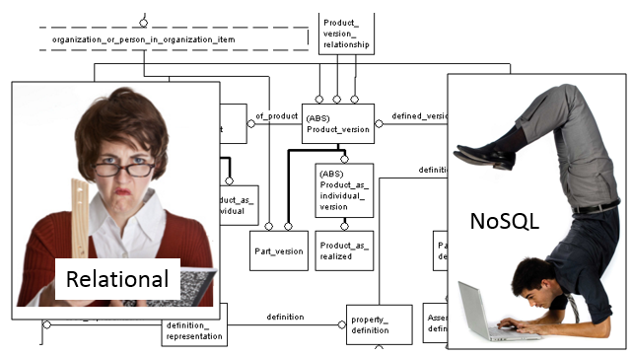
NoSQL vs SQL
SQL | NoSQL
Guaranteed consistency | Eventual consistency
Transactions | No transaction support
Schema | Schemaless
Joins | Flat data
Scale Up (hardware) | Scale out (distribiuted)
TSQL/PL-SQL (view, stored procedures) | Map Reduce/ Code

Slide 5
Types of NoSQL Databases:
Key-Value Store
Column Family
Document Databases
Graph Databases
Notes:
Lesson descriptions should be brief.

Slide 6



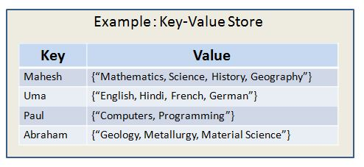
Key-Value Store
Implements Hash Table methodology
Data Model
Global key-value mapping
Big scalable Hash Map
Pros: Fast lookups, simple API (put, get, delete)
Cons: no way to query base on the value
Best with: Less complex huge data sets
Session
User preferences

Slide 7



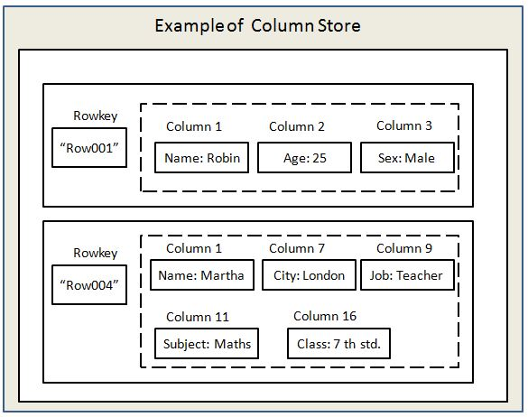
Column family
Most based on idea of Google BigTable
Store data in columnar format
Allow key-value pairs to be stored and retrived on key
PROS: Fast read and write
CONS: no secondary index

Slide 8



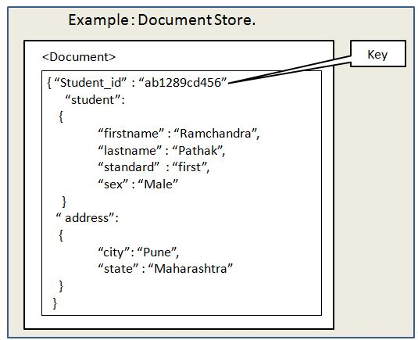
Document Databases
Data Model:
A collection of documents
A document is a key value collection
Best with: file/document related complex data
Event logging
Tracing

Slide 9



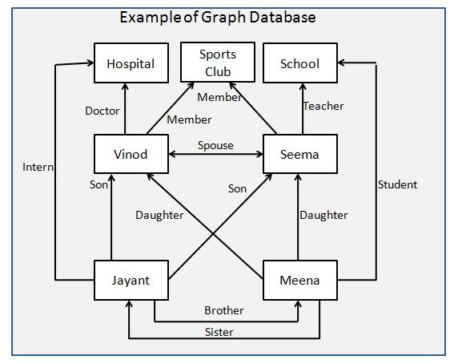
Graph Databases
Data is stored in a series of nodes, relationships and properties
Queries are really graph traversals
Transactional (at least neo4j)
Pros: fast network search, transactions
Cons: Poor scalability when graphs don’t fit into RAM
Notes:
Example objectives
At the end of this lesson, you will be able to:
Save files to the team Web server.
Move files to different locations on the team Web server.
Share files on the team Web server.

Slide 10
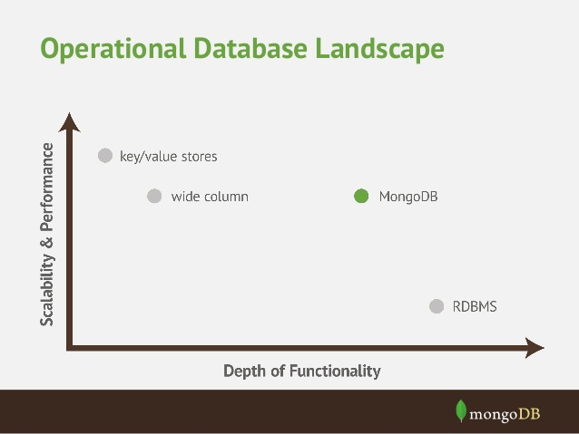

Slide 11
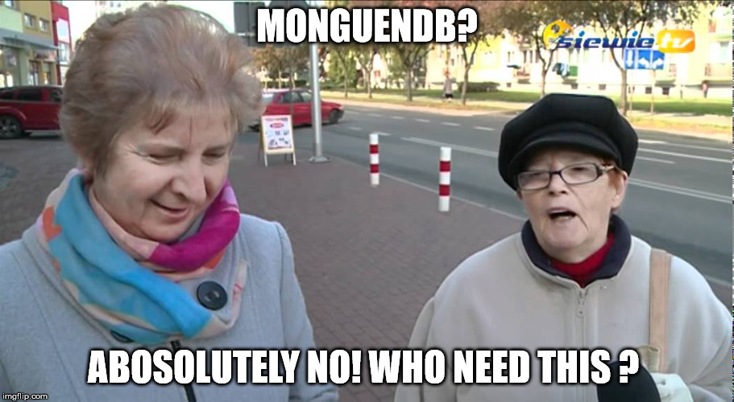
What is MongoDB
Scalable High-Performance open source document database
Schema less
Full index support
Primary, secondary, multi field indexes
Geospartial index
Complex queries
Map/Reduce , Aggregation framework
GridFS – storing files in DB
Easy Scalability

Slide 12
What is MongoDB great for ?
+ Real-time Analytics
+ High Speed logging
+ Caching and high scalability
+ GIS solutions (support geo-spartial indexes)
- Highly transactional applications
- Problems requiring SQL

Slide 13


Some companies using MongoDB in Production

Slide 14
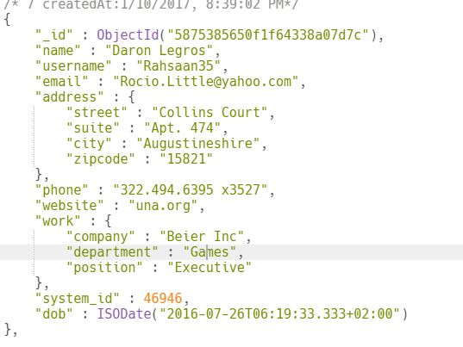
Terminology
When I say Database I think Database
Made up of multiple collections
Created on the fly when referenced for the first time
When I say Table I think Collection
Schema-less, contains Documents
Indexable
Created on the fly, when first time referenced
When I say Record/Row I think Document/object
JSON formatted
Can have _id key (works like primary key in RDMS)
Stored in BSON files (binary form of JSON)

Slide 15

DEMO 1
Creating database, collections

Slide 16
How do I…
...select all record from Games department
db.users.find({"work.department":"Games"})
… find all from dept=Electronics and working as Specialist
db.users.find({"work.position":"Specialist","work.department":"Electronics"})
… find all from dept=Games or Movies
db.users.find({$or: [ {"work.department":"Games"},{"work.department":"Movies"} ]})
… find all born after 2016-11-21 08:09:00
db.users.find({"dob":{$gt:ISODate("2016-11-21 08:09:00")}})
… find all with system between 50900 and 60900
db.users.find({"system_id":{$gt:50900,$lt:60900}})

Slide 17
Query selectors
$eq | Matches values that are equal to a specified value.
$gt | Matches values that are greater than a specified value.
$gte | Matches values that are greater than or equal to a specified value.
$lt | Matches values that are less than a specified value.
$lte | Matches values that are less than or equal to a specified value.
$ne | Matches all values that are not equal to a specified value.
$in | Matches any of the values specified in an array.
$nin | Matches none of the values specified in an array.

Slide 18
Logical operators
$or | Joins query clauses with a logical OR returns all documents that match the conditions of either clause.
$and | Joins query clauses with a logical AND returns all documents that match the conditions of both clauses.
$not | Inverts the effect of a query expression and returns documents that do not match the query expression.
$nor | Joins query clauses with a logical NOR returns all documents that fail to match both clauses.

Slide 19

Cursors
The find() function returns a cursor object
Cursor allows to iterate through the result set

Slide 20
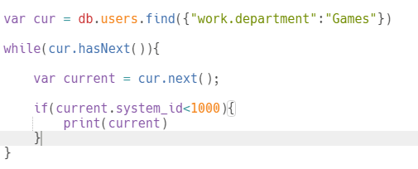
Cursor example

Slide 21
How do I…
… change Customer name
db.cutomers.update({_id:1},{$set:{„name”:”Krzysiek”}}
… insert new customer
db.customers.insert({name:”Krzysiek”,surname:”Nowak”})
… delete all logs
db.logs.remove()
... delete specific row
db.customers.remove({_id:1134})

Slide 22
Indexes
Indexes are important for faster and efficient searching of documents in a collection
Can be created by using the createIndex method.
Can be created on just one field or multiple field values.

Slide 23
How do I...
... create index
db.customers.createIndex({city:1})
... create multiple index
db.customers.createIndex({city:1,name:1})
... create unique index
db.customers.createIndex({evidence_number:1,{unique:true})
... find index on collection
db.customers.getIndexes()
... drop specific index
db.customers.dropIndex({city:1})
... drop all indexes
db.customers.dropIndexes()

Slide 24
_id a.k.a Primary key
_id is the primary key in MongoDB
If you don’t add a field name „_id” MongoDB will automatically add na ObjectId field
Automatically indexed
Any unique value could be used

Slide 25
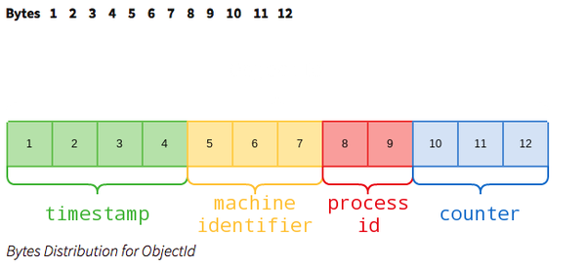
ObjectId
ObjectId is a special 12 byte value
Guaranteed to be unique across your cluster

Slide 26

Demo 2
Doing everyday database work

Slide 27

Who stole my constrains and transactions?
We dont’s have transactions but operations are atomic on the level of a single document
Working with a single document
Implement in software
Just tollerate a little bit of incosistency
MongoDB doesn’t support server side foreign key constraints, but embedding helps

Slide 28
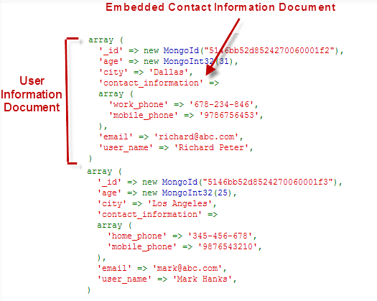
Embedding

Slide 29

And how about joins ?
One to One
One to Many
Many to Many

Slide 30
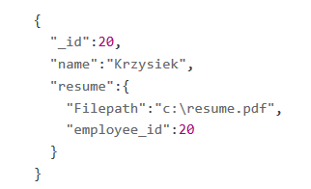
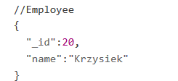
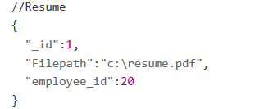
One to one
Keep 2 documents that are related to each other in separate collections
Embedd documents

Slide 31
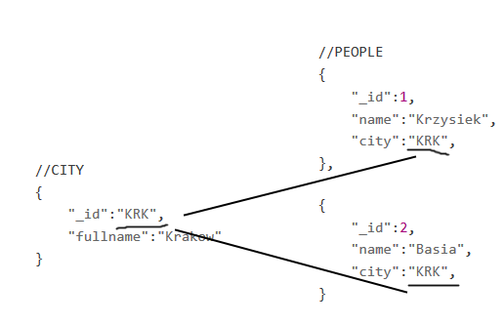
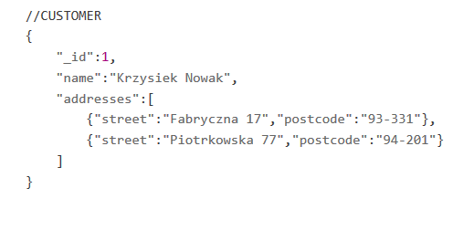
One to many One to few

Slide 32
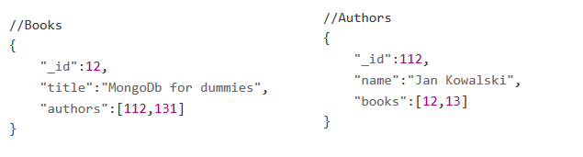
Many to Many

Slide 33
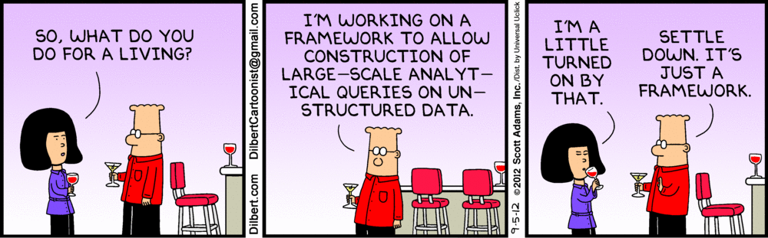
Aggregation framework

Slide 34
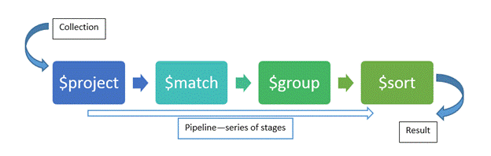
Aggregation pipeline
A series of document transformation
Executed in stages
The output of one stage is passed to the input of next one
Think as a unix pipeline
The input is a single collection

Slide 35
Aggregation functions
Mongo operator | Description | SQL Term
$project | Reshapes a document stream. Can rename, add, remove fields or create computed values | SELECT
$match | Filters the documents to pass only the documents that match the specified condition(s) to the next pipeline stage. | WHERE
$group | Groups documents by some specified expression and outputs to the next stage a document for each distinct grouping. | GROUP BY
$sort | Sorts all input documents and returns them to the pipeline in sorted order. | SORT
$limit | Limits the number of documents passed to the next stage in the pipeline | LIMIT
$unwind | Deconstructs an array field from the input documents to output a document for each element. | PIVOT

Slide 36
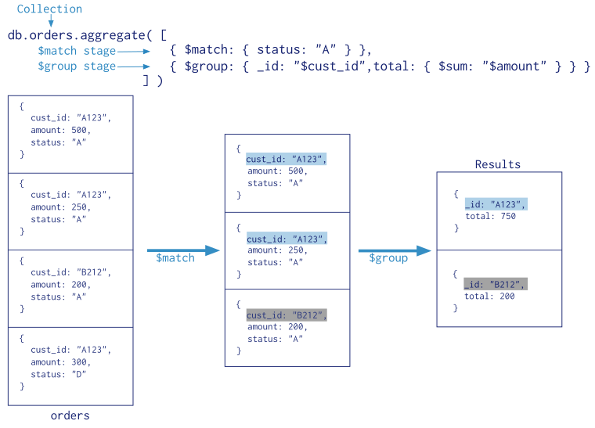

Slide 37

DEMO 3
Aggregation framwork

Slide 38
To sum up
It’s about using the right tool for the job
‘One ring to rule them all’ approach no longer exists
Systems have different data need
NoSql database won’t replace SQL systems
Consider all options and choose wisely
The data is more complex than 15 years ago...
...and it’s bigger than 5 years ago

Slide 39
We have not seen ...
Indexes in depth
Execution plans
Map-Reduce
Bulk operations
GridFS
Full-text support
GeoJson
Aggregation framework in depth
Replication
Security
and many many more..

Slide 40
Useful links
https://docs.mongodb.com/
https://university.mongodb.com/
https://docs.mongodb.com/manual/reference/sql-comparison/
https://github.com/mongodb

Slide 41
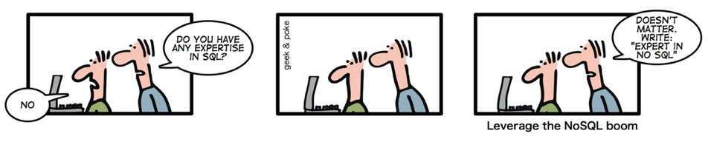
Thank you for your attention. Questions ?

